Slide 1
TIC TAC TOE!
ICP Final Exam: Part II

Slide 2
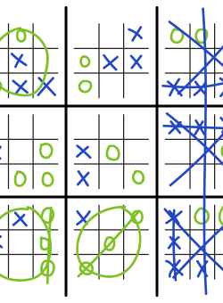
What is Tic Tac Toe?
Tic-tac-toe is a game in which two players take turns in drawing either an ' O' or an ' X' in one square of a grid consisting of nine squares. The winner is the first player to get three of the same symbols in a row

Slide 3
What are we programming for the game?
2 players should be able to play the game (both sitting at the same computer)
The board should be printed out every time a player makes a move
We should be able to accept input of the player position and then place a symbol on the board

Slide 4
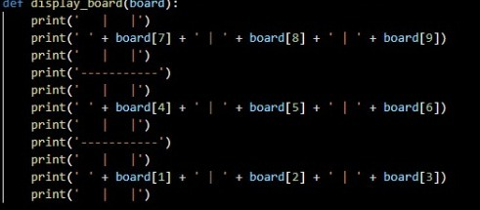
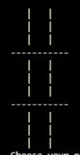
Step 1
Write a function that can print out a board. Set up your board as a list, where each index 1-9 corresponds with a number on a number pad, so you get a 3 by 3 board representation.

Slide 5
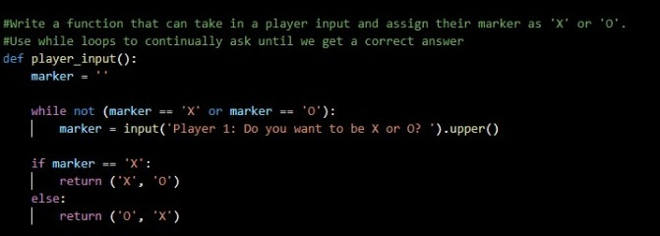
Step 2
Write a function that can take in a player input and assign their marker as 'X' or 'O'. We use while loops to continually ask until you get a correct answer.

Slide 6
Step 3
[7,8,9]
[4,5,6]
[1,2,3]
Write a function that takes in the board list object, a marker ('X' or 'O'), and a desired position (number 1-9) and assigns it to the board.
def place_marker(board, marker, position):
board[position] = marker

Slide 7
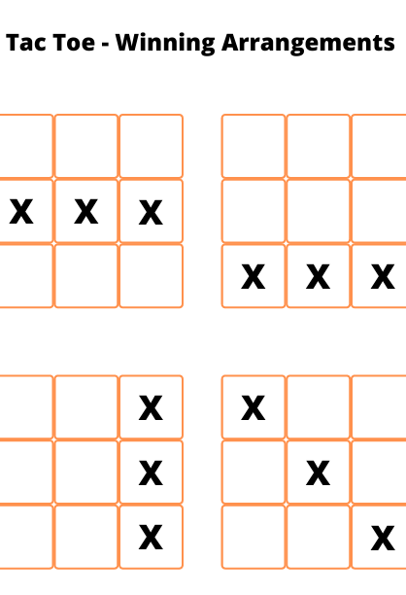
Step 4
Write a function that takes in a board and a mark (X or O) and then checks to see if that mark has won.
Now, someone only wins if they have XXX or OOO in a diagonal or a vertical/horizontal line all together.
So where all the possible outcomes are as follows.
#Write a function that takes in a board and checks to see if someone has won.
def win_check(board,mark):
return ((board[7] == mark and board[8] == mark and board[9] == mark) or # across the top
(board[4] == mark and board[5] == mark and board[6] == mark) or # across the middle
(board[1] == mark and board[2] == mark and board[3] == mark) or # across the bottom
(board[7] == mark and board[4] == mark and board[1] == mark) or # down the middle
(board[8] == mark and board[5] == mark and board[2] == mark) or # down the middle
(board[9] == mark and board[6] == mark and board[3] == mark) or # down the right side
(board[7] == mark and board[5] == mark and board[3] == mark) or # diagonal
(board[9] == mark and board[5] == mark and board[1] == mark)) # diagonal

Slide 8
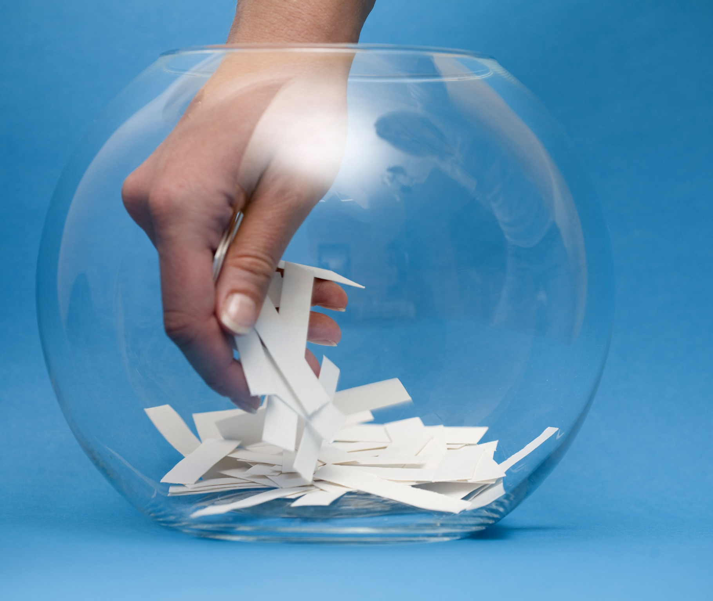
Step 5
Write a function that uses the random module to randomly decide which player goes first. You may want to lookup random.randint() Return a string of which player went first.
import random
def choose_first():
if random.randint(0, 1) == 0:
return 'Player 2'
else:
return 'Player 1'

Slide 9
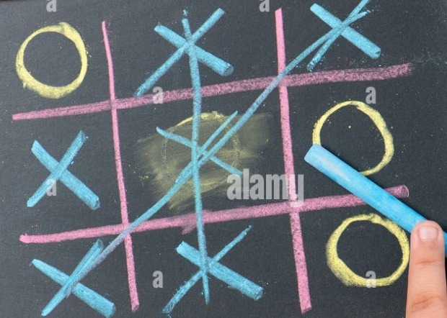
Step 6
Write a function that returns a boolean indicating whether a space on the board is freely available.
def space_check(board, position):
return board[position] == ' '

Slide 10
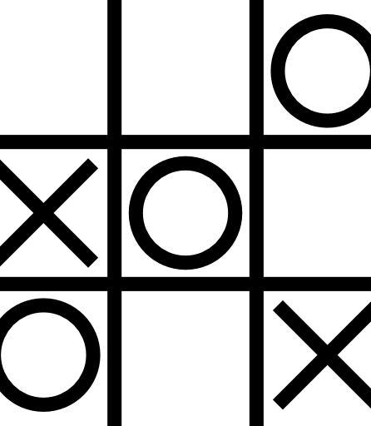
Step 7
Write a function that checks if the board is full and returns a boolean value. True if full, False otherwise.
def full_board_check(board):
for i in range(1,10):
if space_check(board, i):
return False
return True

Slide 11
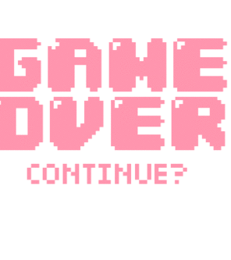
Step 9
Write a function that asks the player if they want to play again and returns a boolean True if they do want to play again.
def replay():
return input('Do you want to play again? Enter Yes or No: ').lower().startswith('y')
print('Welcome to Tic Tac Toe!')

Slide 12

Step 8
Write a function that asks for a player's next position (as a number 1-9) and then uses the function from step 6 to check if it's a free position. If it is, then return the position for use.
def player_choice(board):
position = 0
while position not in [1,2,3,4,5,6,7,8,9] or not space_check(board, position):
position = int(input('Choose your next position: (1-9) '))
return position

Slide 13
Step 10
Now we use while loops and the functions created so far to run the game!
while True:
# Reset the board
theBoard = [' '] * 10
player1_marker, player2_marker = player_input()
turn = choose_first()
print(turn + ' will go first.')
play_game = input('Are you ready to play? Enter Yes or No.')
if play_game.lower()[0] == 'y':
game_on = True
else:
game_on = False
while game_on:
if turn == 'Player 1':
# Player1's turn.
display_board(theBoard)
position = player_choice(theBoard)
place_marker(theBoard, player1_marker, position)
if win_check(theBoard, player1_marker):
display_board(theBoard)
print('Congratulations! You have won the game!')
game_on = False
Else:
if full_board_check(theBoard):
display_board(theBoard)
print('The game is a draw!')
break
else:
turn = 'Player 2'
else:
# Player2's turn.
display_board(theBoard)
position = player_choice(theBoard)
place_marker(theBoard, player2_marker, position)
if win_check(theBoard, player2_marker):
display_board(theBoard)
print('Player 2 has won!')
game_on = False
else:
if full_board_check(theBoard):
display_board(theBoard)
print('The game is a draw!')
break
else:
turn = 'Player 1'
if not replay():
break

Slide 14
Citations
Udemy: Jose Portilla course & Github references for learning Milestone Projects and understanding concepts.
https://www.udemy.com/share/101W8Q3@X7RgyQRh76Pn_aI_V-uG10J_xLqS4KLbMCelDGC_ZDZ-t_YzakQg6V7mHd92SkEY/
https://github.com/Pierian-Data/Complete-Python-3-Bootcamp

